Slide 1
CSCIU 210 Computer Organization AKM Jahangir A Majumder, PhD
Fall 2018 - Lecture 3
August 29, 2018
Note: Some slides are adapted from those used by previous instructors and some slides include figures from the textbook.

Slide 2
Review and Learning Outcomes
We discussed Computer Model and Moore’s law.
Will continue to cover computer performance today
Will learn:
More about Computer performance
Integrated Circuit (IC) Cost
Logic gates and expression
Homework #1 will post on blackboard soon, which will due on Wednesday, Sept. 5 at the beginning of the lecture (Hard Copy)
We will have our first Quiz on Friday, Sept. 9, 2018, which will be on Lectures 1, 2, 3 and 4

Slide 3
Review: CPU Time
Performance improved by
Reducing number of clock cycles
Increasing clock rate
Hardware designer must often trade off clock rate against cycle count

Slide 4
CPU Time Example
Computer A: 2GHz clock, 10s CPU time
Designing Computer B
Aim for 6s CPU time
Can do faster clock, but causes 1.2 × clock cycles
How fast must Computer B clock be?

Slide 5
Instruction Count and CPI
Instruction Count for a program
Determined by program, ISA and compiler
Average cycles per instruction
Determined by CPU hardware
If different instructions have different CPI
Average CPI affected by instruction mix

Slide 6
CPI Example
Computer A: Cycle Time = 250ps, CPI = 2.0
Computer B: Cycle Time = 500ps, CPI = 1.2
Same ISA
Which computer is faster, and by how much?
A is faster…
…by this much

Slide 7
CPI in More Detail
If different instruction classes take different numbers of cycles
Weighted average CPI
Relative frequency

Slide 8
CPI Example
Alternative compiled code sequences using instructions in classes A, B, C
Class | A | B | C
CPI for class | 1 | 2 | 3
IC in sequence 1 | 2 | 1 | 2
IC in sequence 2 | 4 | 1 | 1
Sequence 1: IC = 5
Clock Cycles = 2×1 + 1×2 + 2×3 = 10
Avg. CPI = 10/5 = 2.0
Sequence 2: IC = 6
Clock Cycles = 4×1 + 1×2 + 1×3 = 9
Avg. CPI = 9/6 = 1.5

Slide 9
Performance Summary
Performance depends on
Algorithm: affects IC, possibly CPI
Programming language: affects IC, CPI
Compiler: affects IC, CPI
Instruction set architecture: affects IC, CPI, T_{c}

Slide 10
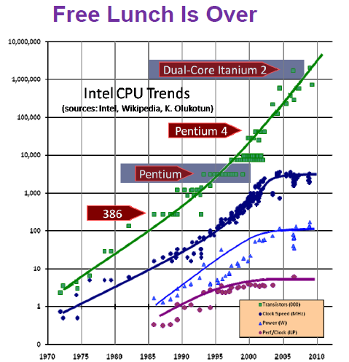
Intel CPU Trends

Slide 11
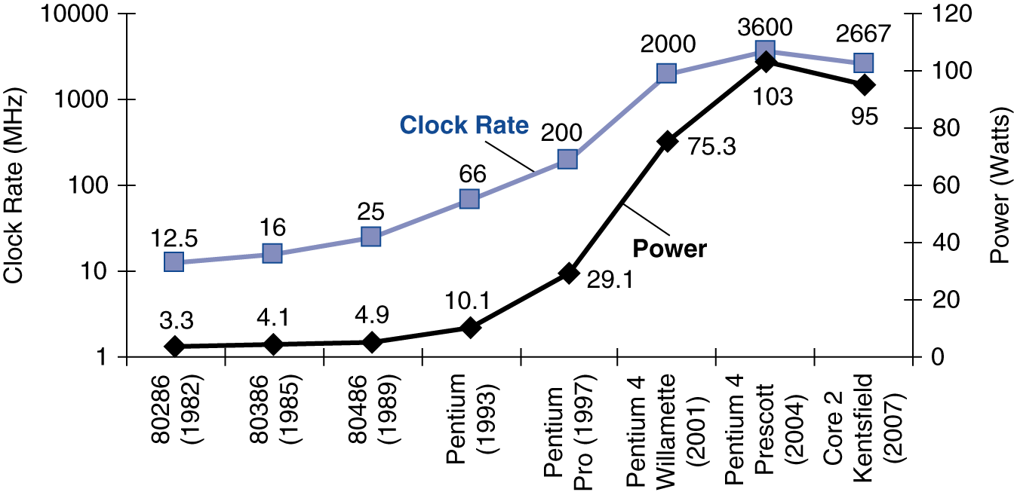
Power Trends
In CMOS IC technology
×30
5V → 1V
×1000

Slide 12
Reducing Power
Suppose a new CPU has
85% of capacitive load of old CPU
15% voltage and 15% frequency reduction
The power wall
We can’t reduce voltage further
We can’t remove more heat
How else can we improve performance?

Slide 13
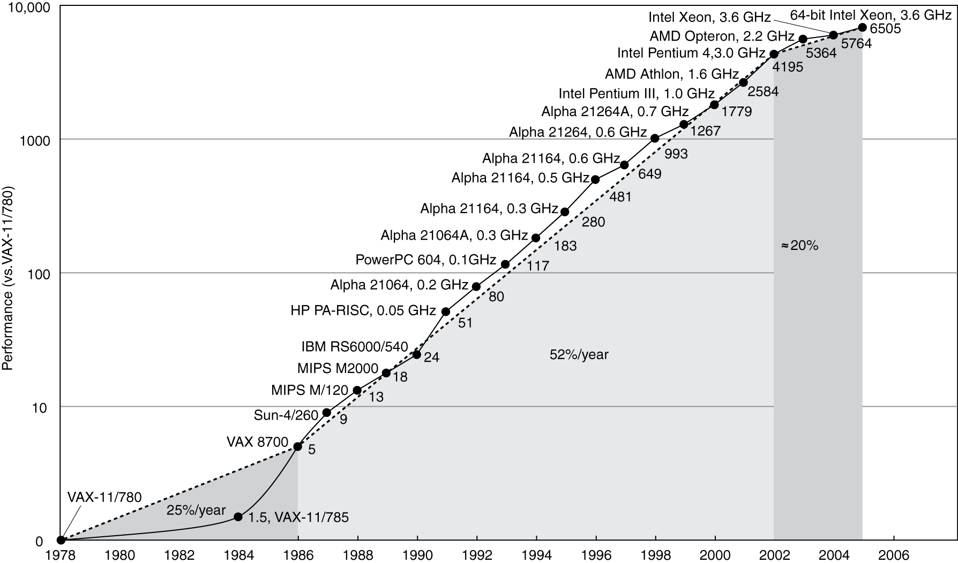
Uniprocessor Performance
Constrained by power, instruction-level parallelism, memory latency

Slide 14
Multiprocessors
Multicore microprocessors
More than one processor per chip
Requires explicitly parallel programming
Compare with instruction level parallelism
Hardware executes multiple instructions at once
Hidden from the programmer
Hard to do
Programming for performance
Load balancing
Optimizing communication and synchronization

Slide 15
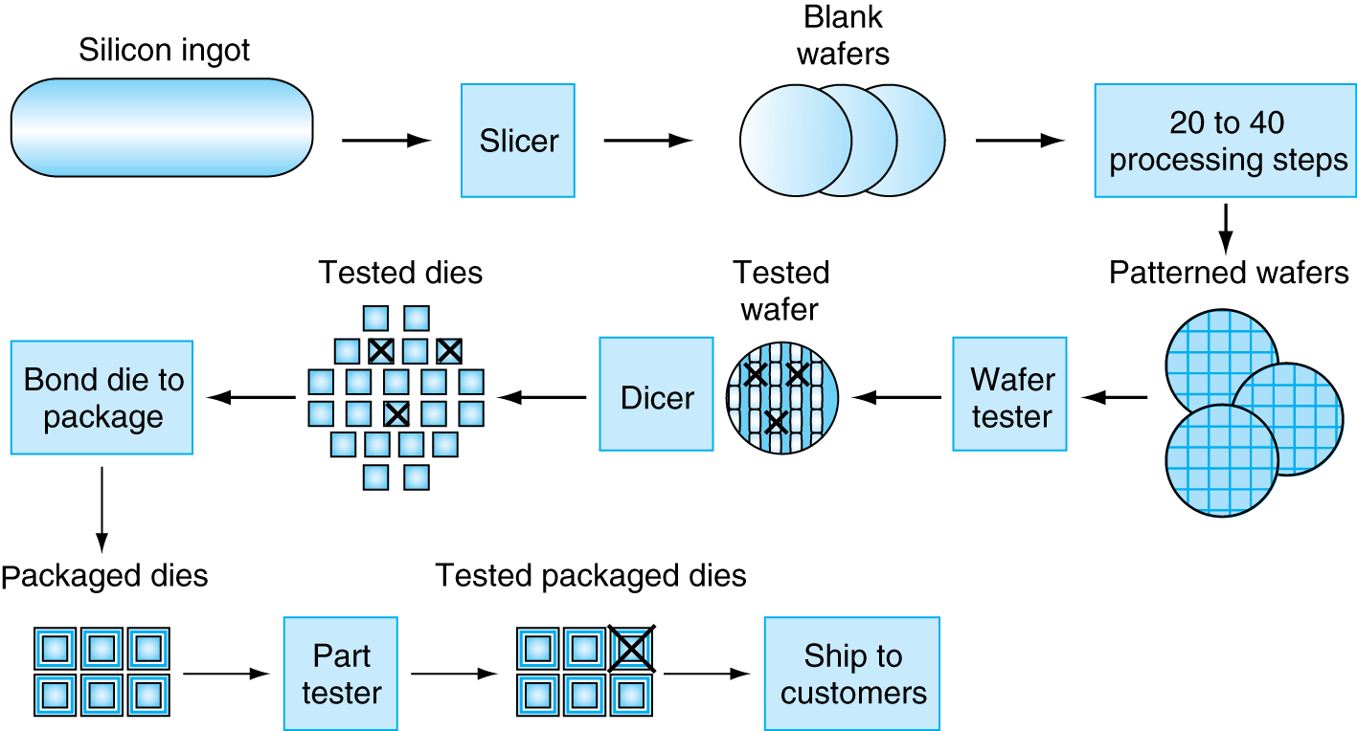
Manufacturing ICs
Yield: proportion of working dies per wafer

Slide 16
Summary
Today, we finished our coverage on computer performance.
We will begin to cover IC and logic gates.
HW 1 will post on canvas soon.

